Slide 1
Writing Boot Camp

Slide 2
Focus (dissecting the prompt) Organization (brainstorming & setup) Support (elaborating and refining on sentence and word level) Conventions (Spelling/Grammar)

Slide 3
Focus

Slide 4
The Prompt Argumentative: Convince (or asks you to pick a side) (requires REFUTATION) - POSITION Explanatory Explain/Inform = NO POSITION If they ask you Why – Give them reasons

Slide 5
Reading the Prompt
Understanding how
to dissect it.

Slide 6
What is a prompt?
The writing prompt is the part that tells you what to write about (the directions).
It is designed to prompt you to write.
Reading it correctly is a critical step in being successful on FSA.
Remember Circle – Square – Underline

Slide 7
Finding the Topic
Most likely in the first sentence
In the Circle the write the topic
and mark it with a “T”.

Slide 8
Expository or argumentative?
Most likely in the last sentence
In your Box write the word that tells you whether to Explain or Argue and mark it with either a “E” or “A”.

Slide 9
What to Write About…
Most likely in the last sentence
Above the Underline tell you what you have to Write About and label it “WA”.

Slide 10
Example 1
Writing Situation
Most people enjoy the holidays.
Directions for Writing
Think about your favorite holiday. Now explain why you like your favorite holiday.
T
E
WA

Slide 11
Example 2
Writing Situation
You want a new puppy for your birthday. Your parents are considering this as your gift.
Directions for Writing
Think about why you should get a new puppy. Write to convince your parents to get you a new puppy for your birthday.

Slide 12
Example 3
Writing Situation
Your principal wants to invite a celebrity speaker to your school.
Directions for Writing
Think about the celebrity you would choose to have speak at school. Now write to persuade your principal why your celebrity should be chosen.

Slide 13
Example 4
Writing Situation
The school board is considering allowing cell phones at limited times during the school day.
Directions for Writing
Think about why this decision would be good or bad for education. Now write to convince the school board why your opinion on cell phone use is important.

Slide 14
Example 5
Writing Situation
Most people enjoy birthdays and birthday parties.
Directions for Writing
Think about your favorite birthday or birthday party. Now write to explain what made that birthday memorable.

Slide 15
FORMULATING A RESPONSE
Start with a Thesis (or claim)
Topic= subject of your paper
EX: (chewing gum)
Thesis = focus of your paper (your position on the topic)
EX: (Gum chewing should be allowed at school)
The thesis statement answers the prompt
Thesis = Expository/ Claim = Argumentative

Slide 16
Add your Main Ideas:
You will need to have three main ideas that are clear, simple, concrete, and a mile apart (totally different from each other)
Brainstorm additional ideas if you can…..
This helps to not run out of things to say.

Slide 17
Recycled Main Ideas – ideas that you can use over and over again! For instance, if the prompt deals with people:
Inspiring or Inspirational Courageous Generous Loving Supportive Dependable Kind A role model Sophisticated Trustworthy Comical Wise | Unselfish Selfless Responsible Diligent Spontaneous Entertaining Educational Dedicated Motivating Rewarding Reliable Hard worker

Slide 18
Recycled Main Ideas – Ideas that you can use over and over again! If it deals with other things or places:
Majestic Variety Opportunity Social Friendliness Travel Impact Economy Memorable Challenging Affordable | Adventurous Relaxing Clean or Cleanliness Décor Environment Great Service

Slide 19
Organization

Slide 20
BEFORE we write – BRAINSTORM!!!!!!!!
Don’t care how amazing you think you are. If you haven’t brainstormed to organize your thoughts, your paper will reflect that disorganization and lack of focus.

Slide 21
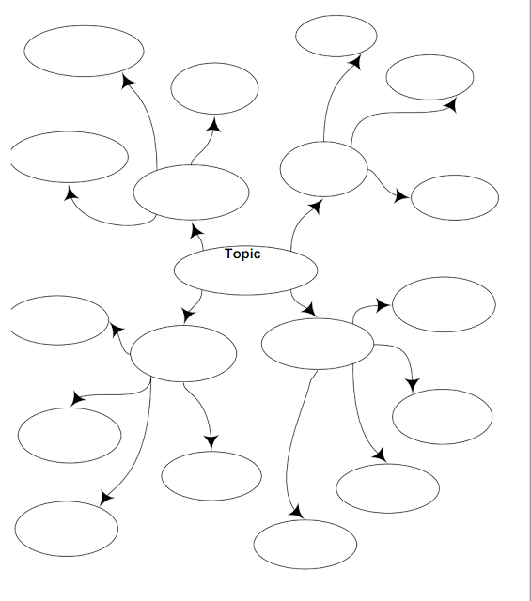
Crazy Brain – Brainstorm Web
2
1
3
4

Slide 22
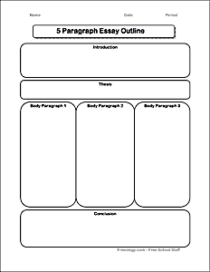
Outline 1
Introduction:
Thesis
Introduction Box
Thesis Box
3 Body Paragraph Boxes
Conclusion Box
Simple. Easy.
Body P. 1
Body P. 2
Body P. 3
Conclusion:

Slide 23
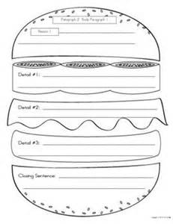
Cheeseburger Paragraph Method Paragraph Topic: 3 details Closing/Transition Sentence

Slide 24
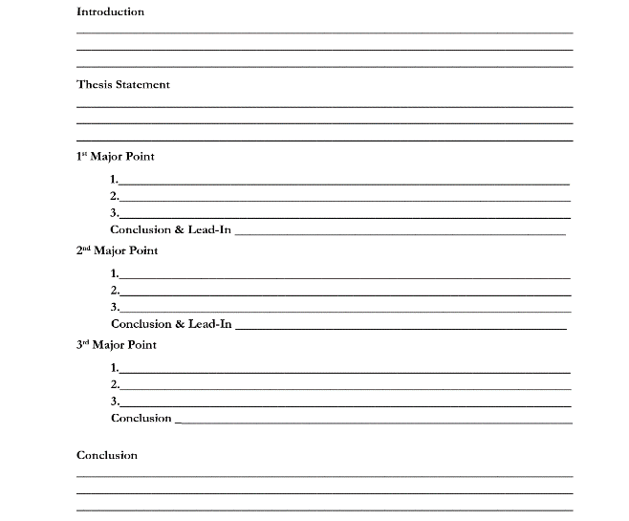
TRADITIONAL OUTLINE

Slide 25
Main Idea 1: ____________________________________________________________________________________ *Supporting Point
* QUOTE
* EXPLAIN QUOTE
Transition Sentence:______________________________________________________________________________
Main Idea 2: _____________________________________________________________________________________ *Supporting Point
*QUOTE
* EXPLAIN QUOTE
Transition Sentence:_________________________________________________________________________
Main Idea 3: ____________________________________________________________________________________
*Supporting Point
*QUOTE
* EXPLAIN QUOTE
Transition Sentence:______________________________________________________________________________

Slide 26
COUNTERCLAIM

Slide 27
Basic Formula Outline

Slide 28
Introduction:
The first sentence should be the GRABBER!!!! Sounds/figurative language/Something to grab the reader’s attention!
The thesis or focus statement should be the last sentence (or close to the last) in your introduction
Three main ideas that are a MILE APART
If it is argumentative, you must address your audience & provide a call to action.

Slide 29
Body Paragraphs- Main Ideas
* Begin with main idea sentence
Explain what you mean
Text Evidence
Explain your quote & how it proves your main idea.
Transition to next paragraph

Slide 30
Conclusion Paragraph
Hint: must be longer than one sentence
Restate your thesis reminding your audience of your main ideas
Circle back to words or phrases in your introduction
Creative closings work!
(If it’s Argumentative, you must have a refutation (counterclaim)

Slide 31
Check Out the Bones of a Exemplary Main Idea Paragraph

Slide 32
Anatomy of a Main Idea Paragraph
Write the opening sentence of your paragraph.
Make a strong point connected to your essay – Main Idea
(A) – Answer/Explain your opening sentence
Text Evidence! Show me! Add a specific example (Citations/Evidence)
Explain how the citation relates directly to Main Idea.
Transition to the next body paragraph and repeat

Slide 33
Conclusion Paragraph
Hint: must be longer than one sentence
Restate your thesis reminding your audience of your main ideas
Circle back to words or phrases in your introduction
Creative closings work!
(If it’s persuasive, you must have a call to action: who, what, when)

Slide 34
Support: Paragraph Body

Slide 35
Support (Elaborating)
Two main forms of support
* Citations either from – inside the text or - outside research
* Concrete – Prior knowledge facts ***

Slide 36
Burden of Proof
When you want to make a clear point in your essay:
Keep it tight
No straying
Don’t need to be cute
Fluffing is not necessary (no false facts)
2. “Support” doesn’t just mean “stay on topic.”
It means prove the main idea with evidence!
Writer MUST know the MAIN IDEA!!

Slide 37
Precise Diction (Word Choice)
Really, when is the color blue JUST BLUE?
Kagan – Round Robin all the different colors of BLUE
stone washed denim blue
blue
electric cobalt blue
crystal-ice translucent blue
Innocent baby blue
turquoise blue
Cry me a river blue
midnight navy blue

Slide 38
Precise Word Choice and Specificity
Exercise to prove YUMMY, delicious, amazing, great, thrilling, etc…
Briefly describe it (yummy pizza) thick, crispy crust piled high with gooey cheese
What do you say? “Ummmmmm, this is the best pizza ever. I just can’t get enough!”
What do you do or look like? Stuffed mouth, smacking lips, rubbing belly
(This lesson is effective for Show Don’t Tell as well)

Slide 39
Dead Words – They are Dull, Dull, Dull Just Don’t Use Them!!!
DEAD WORDS | ALTERNATIVE
a lot, lots | Numerous, heaps, many scores, innumerable, much a great deal, many times, often
also | Too, moreover, besides, as well as, in addition to
awesome, cool, rad | fine, wonderful, marvelous, fantastic, excellent
awful | dreadful, alarming, frightful, terrible, horrid, shocking
but | however, moreover, yet, still, nevertheless, though, although, on the other had
fun | pleasant, pleasurable, amusing, entertaining, jolly
funny | amusing, comical, laughable, jovial, strange, peculiar, unusual
got, get | received, obtained, attained, succeed in
good | excellent, exceptional, fine, marvelous, splendid, superb, wonderful
great | wonderful, outstanding, marvelous, fantastic, excellent
guy | man, person, fellow, boy, individual
have to | need to, must
kid | child, boy, girl, youngster, youth, teen, teenager, adolescent
like | such as, similar to, similarly
mad | angry, frustrated, furious, incensed, enraged, irate

Slide 40
nice | pleasant, charming, fascinating, captivating, delightful, pleasurable, pleasing
pretty | attractive, comely, beautiful
scared | afraid, fearful, terrified, frightened
so | this, according, therefore
then | first, second, next, later, finally, afterwards, meanwhile, soon
very | extremely, exceedingly, fantastically, unusually, incredibly, intensely, truly, fully, especially, shockingly, bitterly, immeasurable, infinitely, severely, surely, mightily, powerfully, chiefly
And the List Goes on!!!

Slide 41
Support: Sentence Variety Precise Diction (Word Choice) Introductions and Conclusion Conventions

Slide 42
Introductions and Conclusion
Primary function is to clearly state the paper’s focus (introduction) and then strongly restate it (conclusion)
Show students strong examples from literature and from student writing (exemplary papers)
Show students how to come full circle with an idea or detail that is found in the introduction and then revisited in the conclusion
Model different ways to start and end essays (especially starting with an illustration)
Let students choose how to develop their method based on what will sound natural to them

Slide 43
Support: Sentence Variety Precise Diction (Word Choice) Introductions and Conclusion Conventions

Slide 44
Conventions

Slide 45
Conventions
A. Spelling
B Punctuation
1. Commas in the following situations – in a series, dates, addresses, beginning and ending quotation marks
2. Commas, semi-colons, and colons
C. Capitalization
D Standard English
1. Subject/verb agreement
2. Noun/Pronoun agreement
3. Pronoun case
4. Possessive forms
5. Homonyms
E. Sentence Structure
Change sentence beginnings:
Begin sentences with adverbs or adverb clauses
Begin sentences with prepositional phrases
Begin sentences with participial phrases
Begin sentences with infinitive phrases
F. Combine sentences:
Appositives
Compound sentences
Complex sentences

Slide 46
4 Basic Elements of Effective Writing
Focus:
Creates a focus statement
Maintains focus using concrete main ideas
Remains unified throughout; lacks loosely related details
Organization:
Is structured; organized around a pattern
Arranges ideas logically
Uses transitional devices effectively, both between and within paragraphs
Support:
Proves and illustrates main points with anecdotes, examples, facts
Uses mature, precise word choice, especially accurate verbs and specific nouns
Conventions:
Uses a variety of sentence structures
Is relatively free of mechanical and spelling errors

